Slide 1
Transport SYstem
20k-0200 Muhammad usman malik
20k-1034 muhmmad shahroz Siddiqui
20k-0368 mohammad hammad shakeel
Bscs-1a

Slide 2
Motivation
Fast is lacking a user end digitized system that will make generating and cataloging information of the university body simple fast and effective. To achieve efficiency, we bring this system with integrated user and admin functionality.

Slide 3
Research
We asked the transport company about the routes they offered to their respective students and staff members. We asked students and staff about the amount they paid for the transport and adjusted our algorithm to meet those points. Our admin block ensures that no one except admin who have password access can access its commands such as printing passenger data or deleting passenger data.

Slide 4
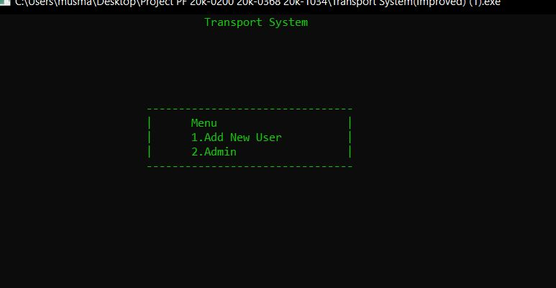
inputs
There are a number of Inputs in this program which can be categorized into User and Admin inputs. The main menu is present as such:

Slide 5
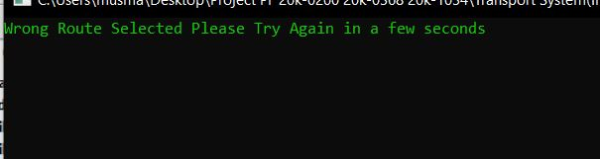
Input data issues:
As the data is input by the user he can make several mistakes and to prevent this we have implemented error checking code and error output messages throughout the program which will return the user to a previous involatile state of the program such as:

Slide 6
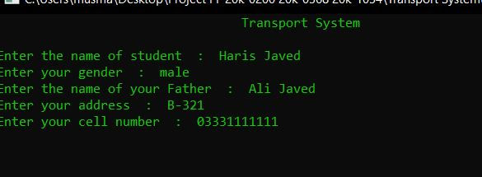
User end inputs:

Slide 7
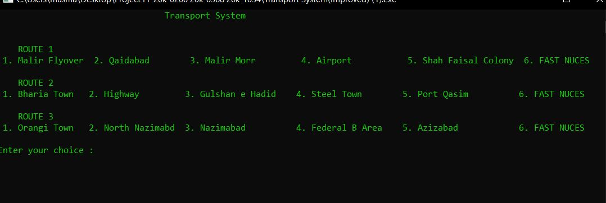
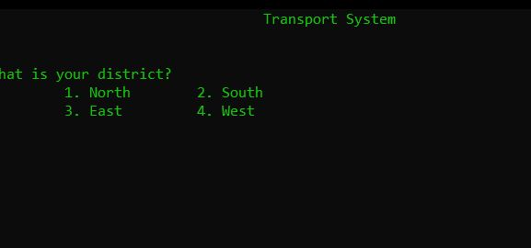
User end inputs district and route/bus selection

Slide 8
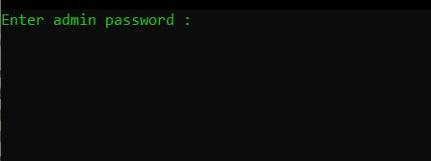
Admin end inputs
Admin block is protected by password “fast1234” and correct password is needed to enter it.
Here Admin can print Passenger Data and Delete Passenger Data.

Slide 9
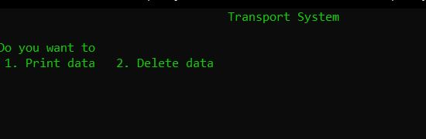
Admin end inputs Admin Main menu

Slide 10
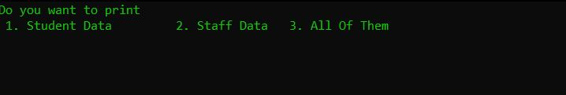
Admin data inputs Printing data
Admin can print Student/Staff or all data simultaneously

Slide 11
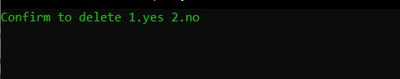
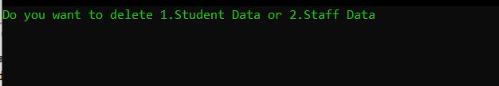
Admin data inputs deleting data
Data Can be deleted by searching by phone number in either student or staff file.

Slide 12

Admin end inputs deleting

Slide 13
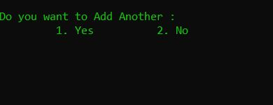
Return to menu input
This input is used to return to main menu

Slide 14
outputs
There are a number of Outputs in this program which can be categorized into User , Admin and Error Outputs.

Slide 15
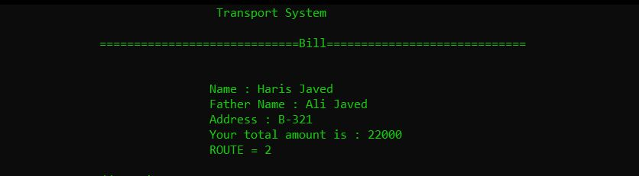
User end outputs bill

Slide 16
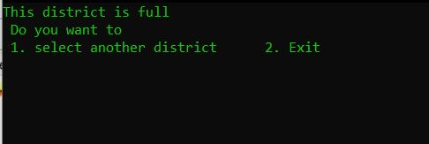
User end outputs District full
If a district ( North/ South/ East/ West) is full then user will be outputted that it is full and whether to select another district or end the program .

Slide 17
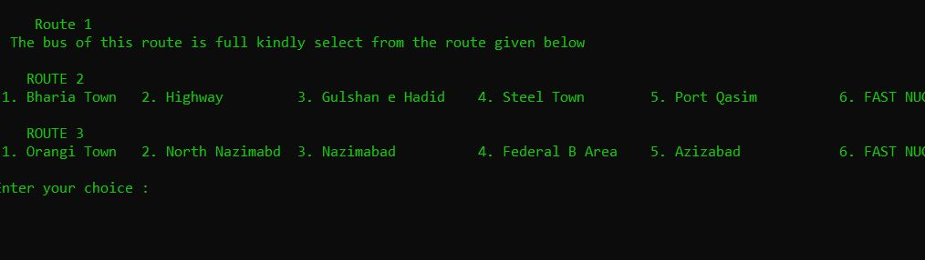
User end outputs route full
If only a route is full then it will display it ass full and not show its locations and user is also unable to select this route.

Slide 18
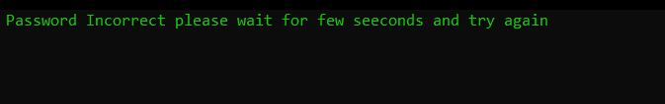
Admin end outputs
Admin block is protected by password “fast1234” and correct password is needed to enter it.
If wrong Password is entered then it will output that it is incorrect and reload.

Slide 19

Admin end outputs multiple wrong password
If Password is entered incorrectly 3 times in a row then the program will output the following and return to main menu:

Slide 20
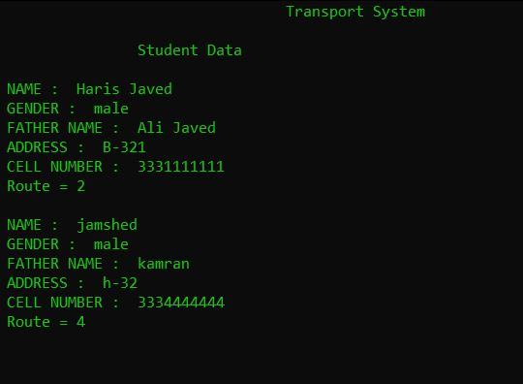
Admin end outputs printing data
Admin can print Student/Staff or all data simultaneously
Here we select student data

Slide 21
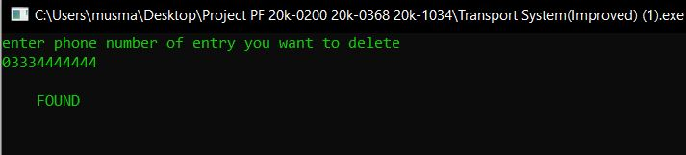
Admin end outputs deleting data
Phone number is searched in files and if found a “Found” is displayed and data is deleted in file but if not found a “Not found” is displayed.

Slide 22
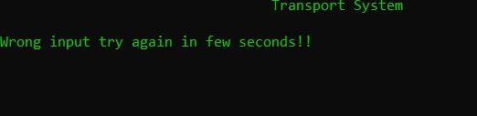
Error outputs
Program has multiple error outputs such as this error in main menu:

Slide 23
Animations
We programed a .h file to include in our program which included two animations for our programs
1. A Biggening/Welcome Animation
2.An Ending Animation

Slide 24
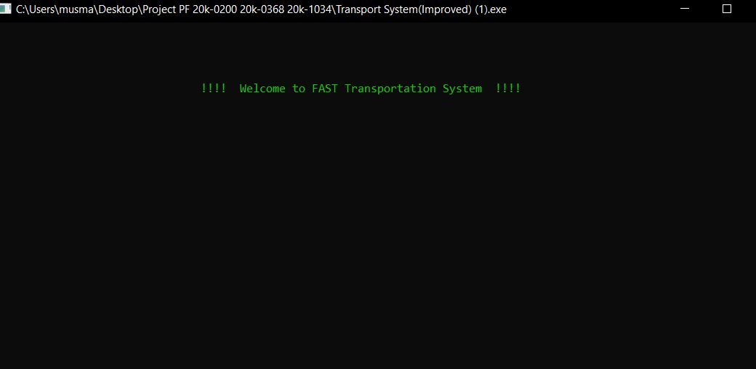
Animations intro

Slide 25

Animations outro

